Slide 1
Teen Mental Health Advocacy Project – The Data
Sarah Agosta

Slide 2
Mission
This analysis seeks to inform the public and illuminate disparities in adolescent mental health through data analysis and support efforts to expand timely, evidence-based care in school settings. By identifying key trends across demographics, the goal is to inform strategies that address unmet needs and close gaps in access to critical mental health services.

Slide 3
Dataset - Youth Risk Behavioral Surveillance System (YRBSS)
The Youth Risk Behavior Surveillance System (YRBSS) collects data on behaviors and experiences that affect the physical and mental health of adolescents in grades 9-12. The insights from this survey help track national trends, identify new concerns, and guide the development and evaluation of programs aimed at improving youth well being.

Slide 4
Data Analysis - Shiny App
This app analyzes responses to the CDC’s YRBSS question about prolonged sadness and hopelessness among adolescents in years 2019, 2021, and 2023.
Users can explore trends by key demographics including location, race/ethnicity, and sex, and view the percentage of students by year who answered “yes” to the question: “During the past 12 months, did you ever feel so sad or hopeless almost every day for two weeks or more in a row that you stopped doing some usual activities?”

Slide 5
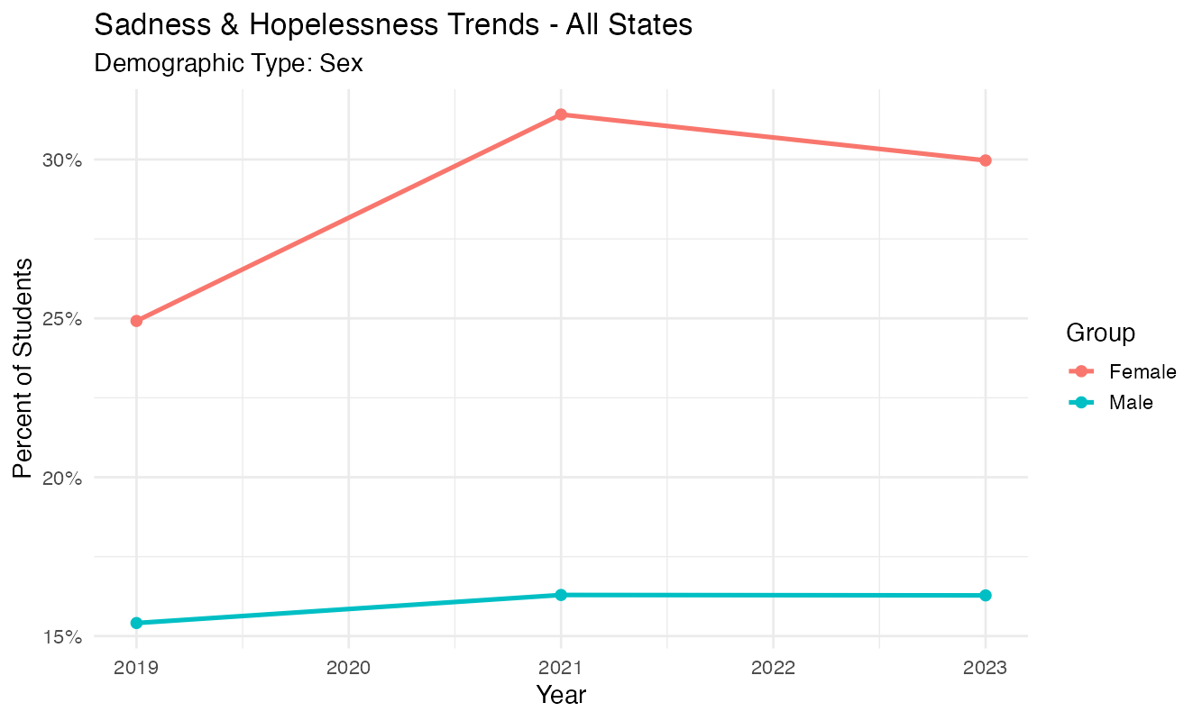
Data Analysis – Sadness & Hopelessness Trends by Sex (2019-2023)
Trend Comparison:
Female students consistently reported higher percentages than male students in each survey year.
Female Students:
The percentage increased from 25% in 2019 to a peak of 32% in 2021, followed by a slight decrease in 2023.
Male Students:
Percentages remained relatively stable, ranging from 15.5% to 16.5% across all years.

Slide 6
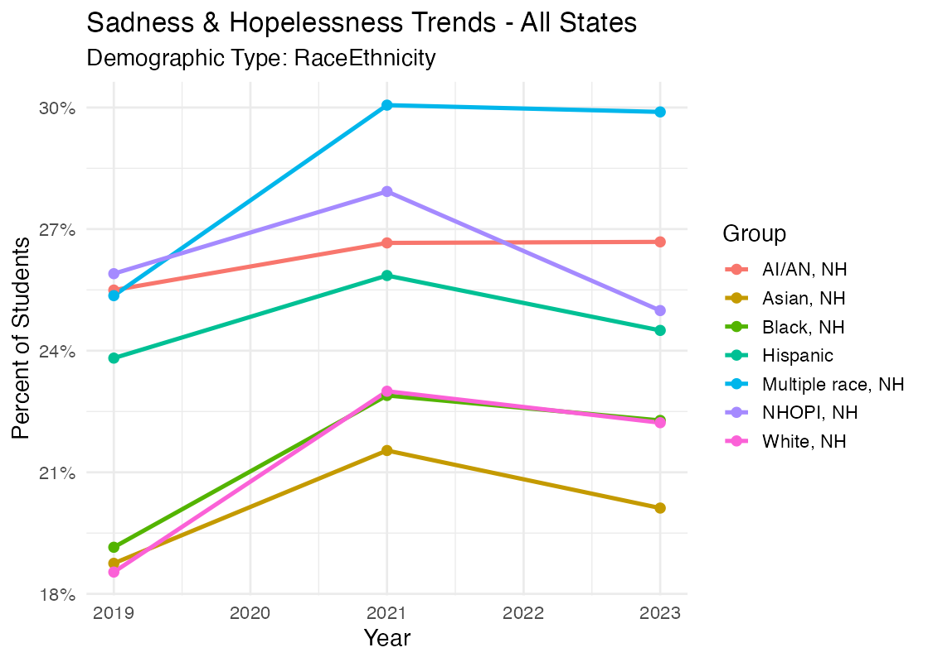
Data Analysis – Sadness & Hopelessness Trends by Race/Ethnicity (2019–2023)
Highest Percentages:
Students identifying as “Multiple race, NH” reported the highest percentages across all years shown, peaking around 30% in 2021.
Increase in 2021:
All racial/ethnic groups showed an increase in reported sadness and hopelessness in 2021 compared to 2019.
Change from 2021 to 2023:
From 2021 to 2023, several groups (e.g., Hispanic, NHOPI, White) showed slight declines, though values remained higher than in 2019.
Lowest Percentages:
Asian, NH and Black, NH groups reported the lowest percentages across the time range.

Slide 7
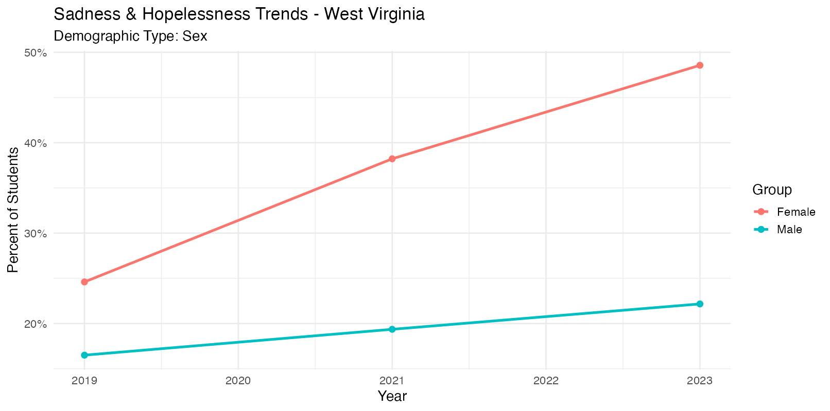
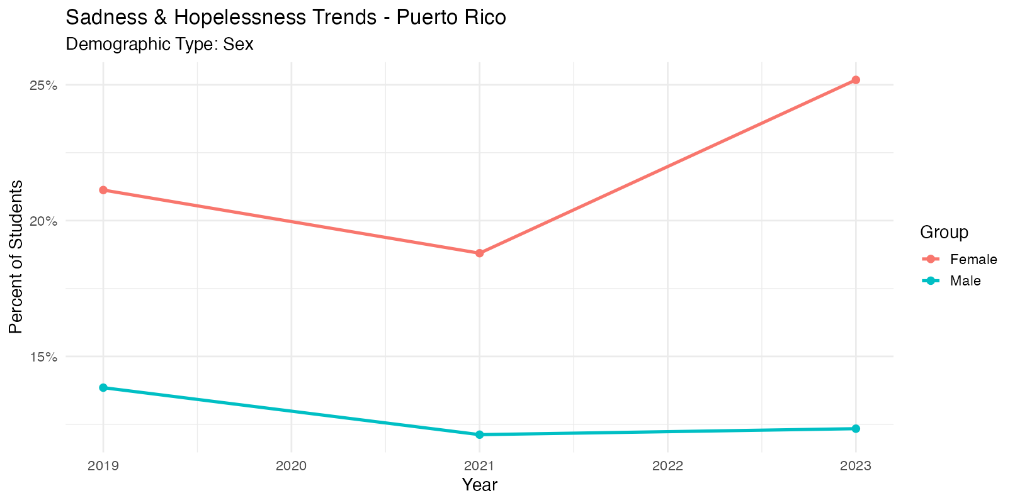
Data Analysis – Sadness & Hopelessness Trends by Sex (Female) and Location (West Virginia and Puerto Rico)
In West Virginia, Females reported “yes” to feeling sad and hopeless the most out of any state. there's a steady and sharp increase from 2019 to 2023.
In Puerto Rico, Females reported “yes” to feeling sad and hopeless the least out of any state. the trend is more variable. it declines through 2021 and rises again in 2023 but remains significantly lower than West Virginia throughout.

Slide 8
Conclusion
This analysis reveals concerning trends in youth mental health across the United States. Over the past several years, an increasing percentage of high school students have reported experiencing prolonged sadness and hopelessness, with notable disparities across states, racial/ethnic groups, and sex. Female students and students identifying as multiple race, non-Hispanic, consistently show higher reported rates compared to their peers.
These patterns highlight the urgent need for continued investment in school based mental health services, targeted interventions, and policy efforts aimed at supporting vulnerable adolescent populations.
More data is needed regarding students who identify as nonbinary or transgender, as well as youth with disabilities, who are currently missing or unidentified in this dataset. Additionally, the impact of socioeconomic status, family structure, and access to support systems are not captured here but are likely to play a critical role in youth mental health outcomes.
While the current data provide valuable insight, ongoing efforts will be essential to fully understand the scope of this issue and to develop effective, evidence based responses.

